Slide 1
Management Stephen P. Robbins | Mary Coulter Thirteenth Edition
Chapter 16 Motivating Employees

Slide 2
Learning Objectives
Define motivation.
Compare and contrast early theories of motivation.
Compare and contrast contemporary theories of motivation.
Develop your skill at motivating employees.
Discuss current issues in motivation.
Know how to identify what motivates you.
© Pearson Education Limited 2016

Slide 3
What Is Motivation?
Motivation – The process by which a person’s efforts are energized, directed, and sustained toward attaining a goal.
energy is a measure of intensity, drive, and vigor (strength)
effort is channeled in a direction that benefits the organization
we want employees to persist in putting forth effort
© Pearson Education Limited 2016

Slide 4
Early Theories of Motivation
Maslow’s Hierarchy of Needs
McGregor’s Theories X and Y
Herzberg’s Two-Factor Theory
McClelland’s Three Needs Theory
© Pearson Education Limited 2016

Slide 5
Maslow’s Hierarchy of Needs Theory
The best-known theory of motivation is probably Abraham Maslow’s hierarchy of needs theory. Maslow was a psychologist who proposed that within every person is a hierarchy of five needs.
Hierarchy of Needs Theory – Maslow’s theory that human needs—physiological, safety, social, esteem, and self-actualization—form a sort of hierarchy.
© Pearson Education Limited 2016

Slide 6
Maslow’s Hierarchy of Needs Theory
Physiological Needs – A person’s needs for food, drink, shelter, sexual satisfaction, and other physical needs.
Safety Needs – A person’s needs for security and protection from physical and emotional harm.
Social Needs – A person’s needs for affection, belongingness, acceptance, and friendship.
© Pearson Education Limited 2016

Slide 7
Maslow’s Hierarchy of Needs Theory
Esteem Needs – A person’s needs for internal factors (e.g., self-respect, autonomy, and achievement) and external factors (such as status, recognition, and attention).
Self-Actualization Needs – A person’s need to become what he or she is capable of becoming.
© Pearson Education Limited 2016

Slide 8
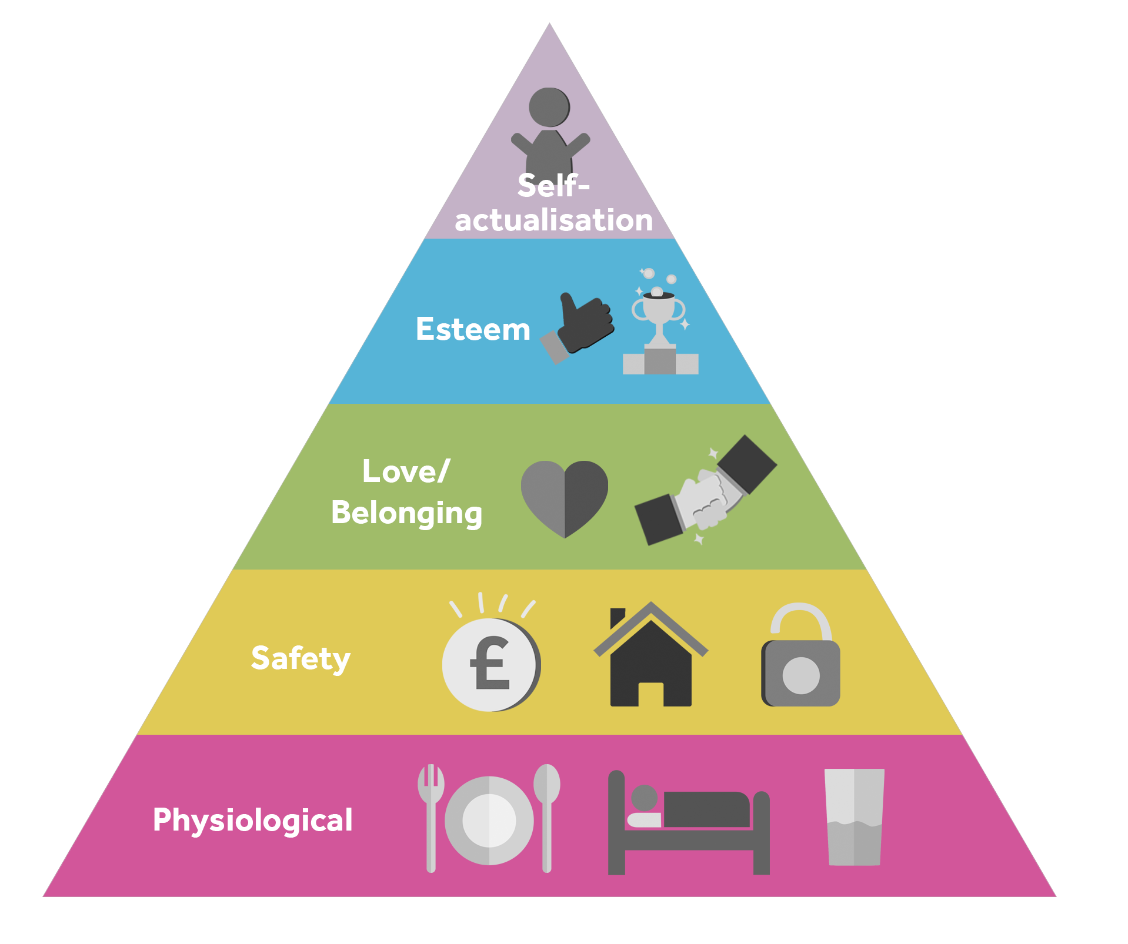

Slide 9
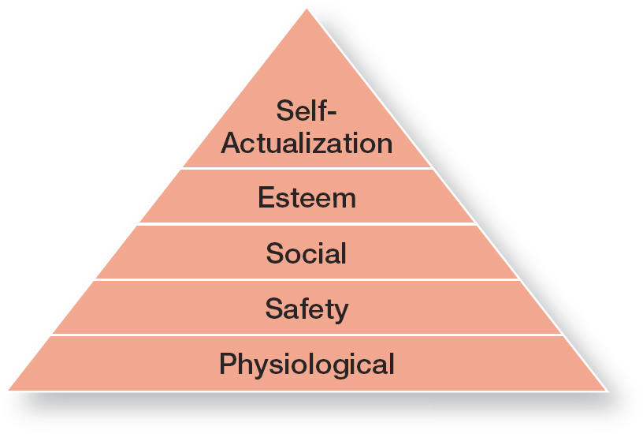
Exhibit 16-1 Maslow’s Hierarchy of Needs
© Pearson Education Limited 2016

Slide 10
McGregor’s Theory X and Theory Y
Douglas McGregor is best known for proposing two assumptions about human nature: Theory X and Theory Y
Theory X (-negative) – The assumption that employees dislike work, are lazy, avoid responsibility, and must be coerced (forced) to perform.
Theory Y (+positive) – The assumption that employees are creative, enjoy work, seek responsibility, and can exercise self-direction.
© Pearson Education Limited 2016

Slide 11
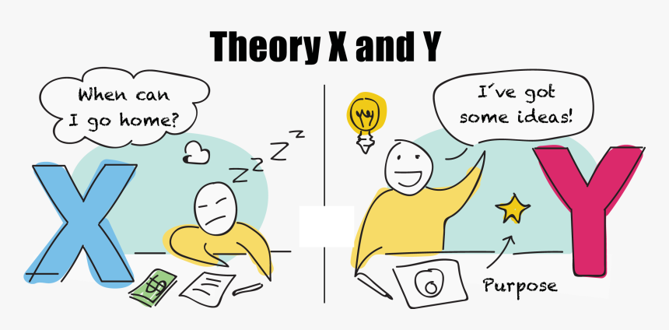

Slide 12
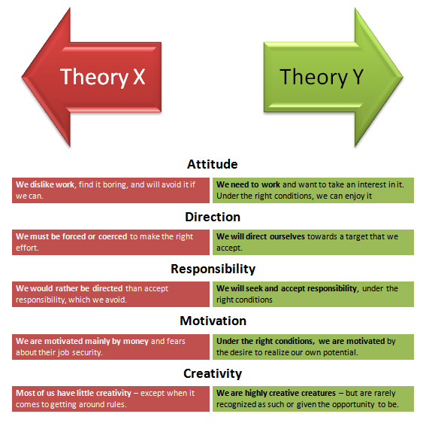

Slide 13
Frederick Herzberg’s Two-Factor Theory
Two-Factor Theory (Motivation-Hygiene Theory) – The motivation theory that claims that intrinsic factors are related to job satisfaction and motivation, whereas extrinsic factors are associated with job dissatisfaction.
Herzberg wanted to know when people felt exceptionally good (satisfied) or bad (dissatisfied) about their jobs.
© Pearson Education Limited 2016

Slide 14
Frederick Herzberg’s Two-Factor Theory
Hygiene Factors – Extrinsic factors that eliminate job dissatisfaction, but don’t motivate. When people felt good about their work, they tended to quote intrinsic factors arising from the job itself.
Motivators – Intrinsic Factors that increase job satisfaction and motivation. when they were dissatisfied, they tended to cite extrinsic factors arising from the job context.
© Pearson Education Limited 2016

Slide 15
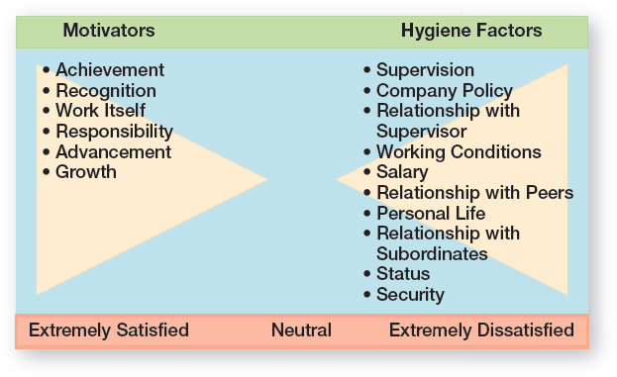
Exhibit 16-2 Herzberg’s Two Factor Theory
© Pearson Education Limited 2016

Slide 16
Frederick Herzberg’s Two-Factor Theory
Herzberg believed the data suggested that the opposite of satisfaction was not dissatisfaction, as traditionally had been believed.
Removing dissatisfying characteristics from a job would not necessarily make that job more satisfying (or motivating). Herzberg proposed that a dual range existed: The opposite of “satisfaction” is “no satisfaction,” and the opposite of “dissatisfaction” is “no dissatisfaction.”
© Pearson Education Limited 2016

Slide 17
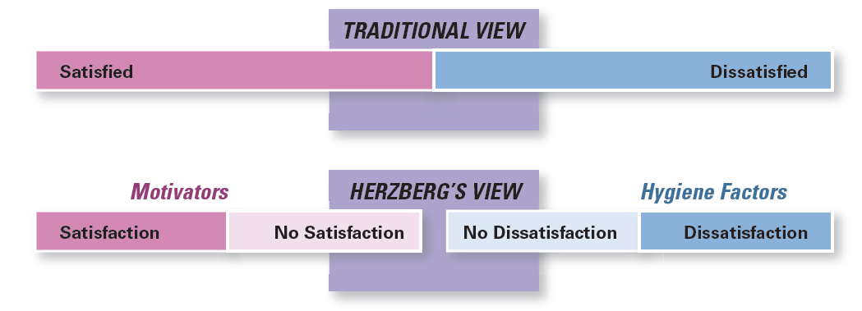
Exhibit 16-3 Contrasting Views of Satisfaction–Dissatisfaction
© Pearson Education Limited 2016

Slide 18
McClelland Three-Needs Theory
David McClelland and his associates proposed the three-needs theory, which says three acquired (not innate) needs are major motives in work.
Need for Achievement (nAch) – The drive to succeed and excel in relation to a set of standards.
Need for Power (nPow) – The need to make others behave in a way that they would not have behaved otherwise.
Need for Affiliation (nAff) – The desire for friendly and close interpersonal relationships.
© Pearson Education Limited 2016

Slide 19
Need for Achievement (nAch)
People with a high need for achievement exhibits following characteristics:
Strive for personal achievement rather than for the trappings and rewards of success
Have a desire to do something better or more efficiently than it’s been done before
They prefer jobs in which they can receive rapid and unambiguous feedback on their performance and in which they can set moderately challenging goals
Avoid what they perceive to be very easy or very difficult tasks
© Pearson Education Limited 2016

Slide 20
Contemporary Theories of Motivation
Goal-setting Theory
Reinforcement Theory
Job Design Theory
Equity Theory
Expectancy Theory
High-involvement Work Practices
© Pearson Education Limited 2016

Slide 21

Goal-Setting Theory
Goal-setting Theory says that specific goals increase performance and that difficult goals, when accepted, result in higher performance than do easy goals.
© Pearson Education Limited 2016

Slide 22
Features of Goal-Setting Theory
Specific and challenging goals are superior motivating forces and produce a higher output
For instance, when a sales rep commits to making eight sales calls daily, this intention gives him a specific goal to try to attain.
Difficult goals will lead to higher performance only if they are accepted
Employees’ participation in goal is not always desirable
People will do better if they get feedback on how well they’re progressing toward their goals. Self-generated feedback has been shown to be a more powerful motivator than feedback coming from someone else
© Pearson Education Limited 2016

Slide 23
Features of Goal-Setting Theory
Three other possibilities influence the goal-performance relationship:
Goal Commitment: Goal-setting theory assumes an individual is committed to the goal. Commitment is most likely when goals are made public, when the individual has an internal locus of control, and when the goals are self-set rather than assigned.
© Pearson Education Limited 2016

Slide 24
Features of Goal-Setting Theory
Self-efficacy: An individual’s belief that he or she is capable of performing a task
High Self-Efficacy | Low Self-Efficacy
confident to succeed in a task | low confidence
try harder to master the challenge | reduce their effort or give up altogether
respond to negative feedback with increased effort and motivation | reduce their effort when given negative feedback
© Pearson Education Limited 2016

Slide 25
Features of Goal-Setting Theory
National Culture: Finally, the value of goal-setting theory depends on the national culture. It assumes that subordinates will be reasonably independent, that people will seek challenging goals, and that performance is considered important by both managers and subordinates.
© Pearson Education Limited 2016

Slide 26
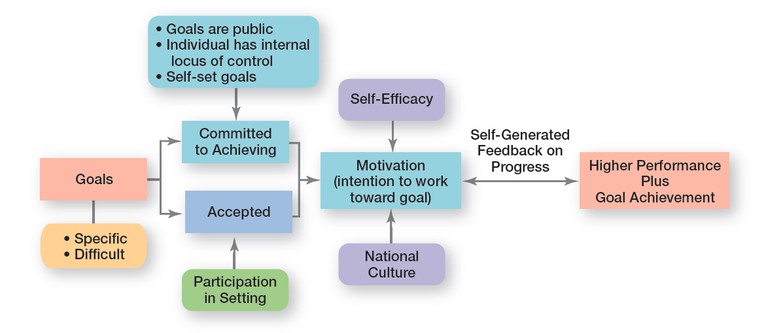
Exhibit 16-5 Goal-Setting Theory
© Pearson Education Limited 2016

Slide 27
Reinforcement Theory
Reinforcement Theory – The theory that behavior is a function of its consequences.
Reinforcers – Consequences immediately following a behavior which increase the probability that the behavior will be repeated.
Reinforcement theory ignores factors such as goals, expectations, and needs. Instead, it focuses solely on what happens to a person when he or she does something.
© Pearson Education Limited 2016

Slide 28
Designing Motivating Jobs
Managers want to motivate individuals on the job, they need to look at ways to design motivating jobs. By looking closely at what an organization is and how it works, you’ll find that it’s composed of thousands of tasks. These tasks are, in turn, combined into jobs.
Job Design – The way tasks are combined to form complete jobs. Managers should design jobs deliberately and thoughtfully to reflect the demands of the changing environment; the organization’s technology; and employees’ skills, abilities, and preferences.
© Pearson Education Limited 2016

Slide 29
Ways to Design Motivating Jobs
Job Enlargement
Job Enrichment
Job Characteristics Model
Redesigning Job Design Approaches
© Pearson Education Limited 2016

Slide 30

Job Enlargement
Job Scope – The number of different tasks required in a job and the frequency with which those tasks are repeated
Job Enlargement – The horizontal expansion of a job by increasing job scope
© Pearson Education Limited 2016

Slide 31
Job Enrichment
Job Enrichment – The vertical expansion of a job that occurs as a result of additional planning and evaluation of responsibilities.
Job Depth – The degree of control employees have over their work.
An enriched job allows workers to do an entire activity with increased freedom, independence, and responsibility.
© Pearson Education Limited 2016

Slide 32
Job Characteristics Model
A framework for analyzing and designing jobs that identifies five primary core job dimensions, their interrelationships, and their impact on outcomes.
1. Skill variety – the degree to which a job requires a variety of activities so that an employee can use a number of different skills and talents.
2. Task identity – the degree to which a job requires completion of a whole and identifiable piece of work.
© Pearson Education Limited 2016

Slide 33
Job Characteristics Model
3. Task significance – the degree to which a job has a substantial impact on the lives or work of other people.
4. Autonomy – the degree to which a job provides substantial freedom, independence, and discretion to the individual in scheduling the work and determining the procedures to be used in carrying it out.
5. Feedback – the degree to which doing work activities required by a job results in an individual obtaining direct and clear information about the effectiveness of his or her performance.
© Pearson Education Limited 2016

Slide 34
Equity Theory
Equity theory, developed by J. Stacey Adams, proposes that employees compare what they get from a job (outcomes) in relation to what they put into it (inputs), and then they compare their inputs–outcomes ratio with the inputs–outcomes ratios of relevant others.
When inequities occur, employees attempt to do something about it. The result might be lower or higher productivity, improved or reduced quality of output, increased absenteeism, or voluntary resignation.
© Pearson Education Limited 2016

Slide 35
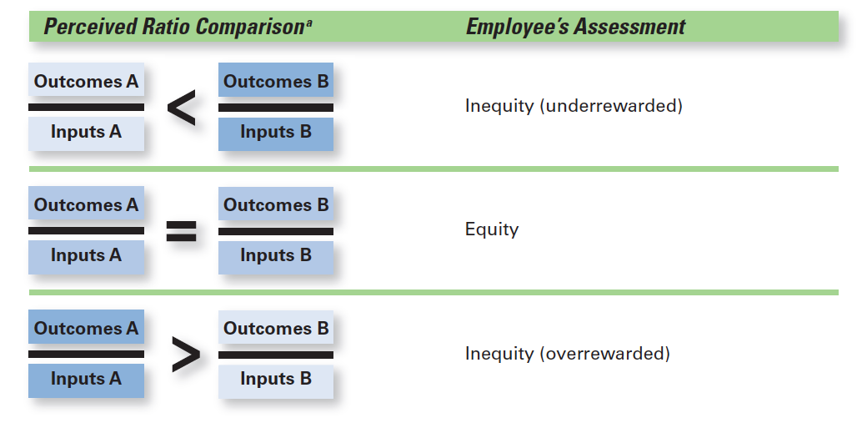
Exhibit 16-7 Equity Theory
© Pearson Education Limited 2016

Slide 36

Equity Theory
Referents – The persons, systems, or selves against which individuals compare themselves to assess equity.
© Pearson Education Limited 2016

Slide 37
Equity Theory
Distributive Justice – Perceived fairness of the amount and allocation of rewards among individuals.
Procedural Justice – Perceived fairness of the process used to determine the distribution of rewards.
© Pearson Education Limited 2016

Slide 38
Expectancy Theory
The most comprehensive explanation of how employees are motivated is Victor Vroom’s expectancy theory. Although the theory has its critics, most research evidence supports it.
Expectancy theory states that an individual tends to act in a certain way based on the expectation that the act will be followed by a given outcome and on the attractiveness of that outcome to the individual.
© Pearson Education Limited 2016

Slide 39
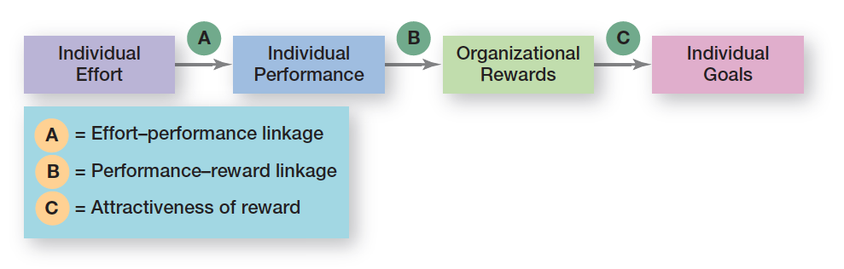
Exhibit 16-8 Expectancy Model
© Pearson Education Limited 2016

Slide 40
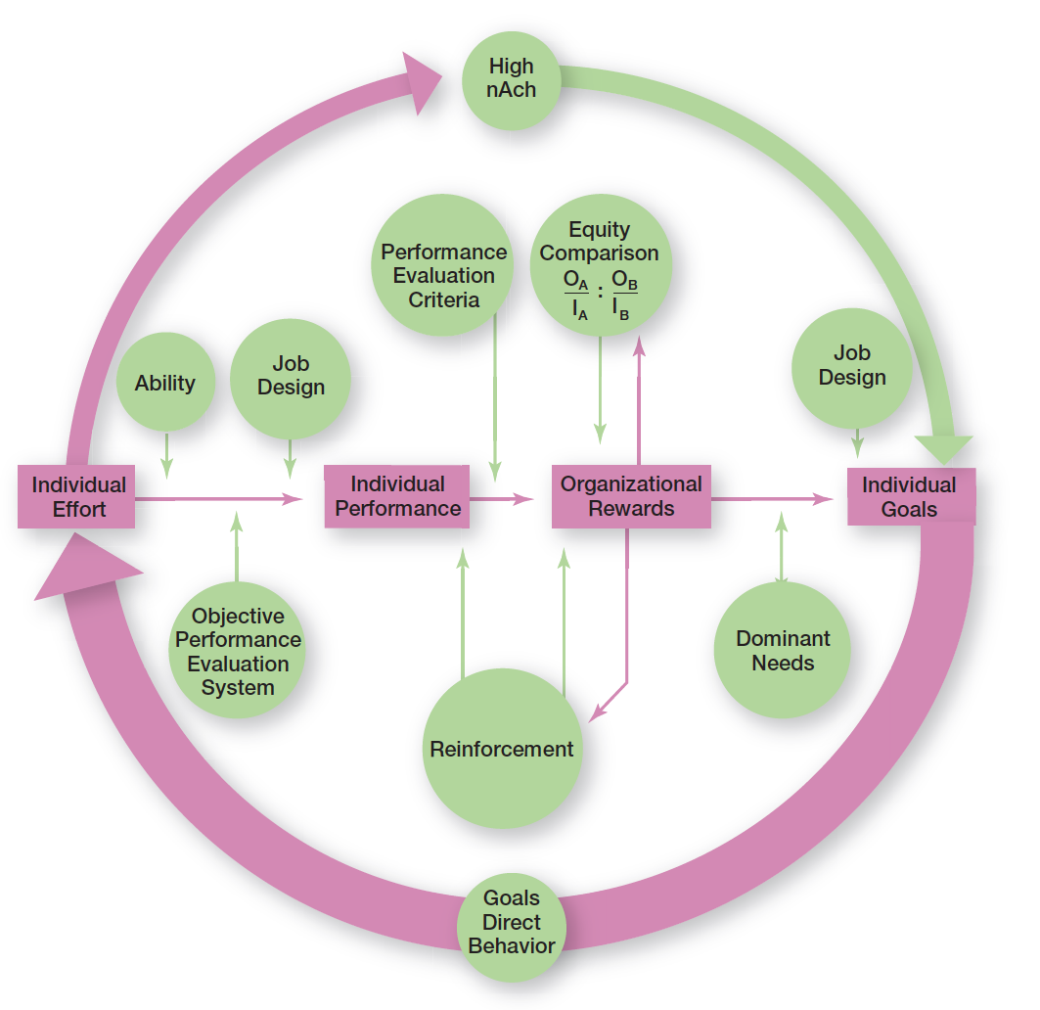
Exhibit 16-9 Integrating Contemporary Theories of Motivation
© Pearson Education Limited 2016

Slide 41
Current Issues in Motivation
Motivating in Tough Economic Circumstances
The economic recession of the last few years was difficult for many organizations.
Layoffs, tight budgets, minimal or no pay raises, benefit cuts, no bonuses, long hours doing the work of those who had been laid off was the reality that many employees faced.
© Pearson Education Limited 2016

Slide 42
Current Issues in Motivation
Managing Cross-Cultural Motivational Challenges
Most current motivation theories were developed in the United States by Americans and about Americans.
Managers can’t automatically assume motivational programs that work in one geographic location are going to work in others.
© Pearson Education Limited 2016

Slide 43
Current Issues in Motivation
Motivating Unique Groups of Workers
Compressed workweek - Longer daily hours, but fewer days.
Flexible work hours (flextime) - Specific weekly hours with varying arrival, departure, lunch and break times around certain core hours during which all employees must be present.
Job Sharing - Two or more people split a full-time job.
Telecommuting - Employees work from home using computer links
© Pearson Education Limited 2016

Slide 44

Current Issues in Motivation
Motivating Professionals
Characteristics of professionals
Strong and long-term commitment to their field of expertise
Loyalty is to their profession, not to the employer
Have the need to regularly update their knowledge
Don’t define their workweek as 8:00 am to 5:00 pm.
© Pearson Education Limited 2016

Slide 45
Current Issues in Motivation
Motivating Contingent Workers
Opportunity to become a permanent employee
Opportunity for training
Equity in compensation and benefits
Motivating Low-Skilled, Minimum-Wage Employees
Employee recognition programs
Provision of sincere praise
© Pearson Education Limited 2016

Slide 46
Designing Appropriate Rewards Programs
Open-Book Management – A motivational approach in which an organization’s financial statements (the “books”) are shared with all employees.
Employee Recognition Programs – Programs based on personal attention and expression of interest, approval, and appreciation for a job well done.
Pay-for-Performance Programs – Variable compensation plans that pay employees on the basis of some performance measure.
© Pearson Education Limited 2016

Slide 47
Review Learning Objective 16.1
Define motivation.
Motivation is the process by which a person’s efforts are energized, directed, and sustained toward attaining a goal.
The energy element is a measure of intensity, drive, or vigor.
The high level of effort needs to be directed in ways that help the organization achieve its goals.
Employees must persist in putting forth effort to achieve those goals.
© Pearson Education Limited 2016

Slide 48
Review Learning Objective 16.2
Compare and contrast early theories of motivation.
In Maslow’s hierarchy, individuals move up the hierarchy of five needs (physiological, safety, social, esteem, and self-actualization).
A Theory X manager believes people don’t like to work or won’t seek out responsibility. A Theory Y manager assumes people like to work and seek out responsibility, so they will exercise self-motivation and self-direction.
© Pearson Education Limited 2016

Slide 49
Review Learning Objective 16.2
Herzberg’s theory proposed that intrinsic factors associated with job satisfaction were what motivated people. Extrinsic factors associated with job dissatisfaction simply kept people from being dissatisfied.
Three-needs theory proposed three acquired needs that are major motives in work: need for achievement, need for affiliation, and need for power.
© Pearson Education Limited 2016

Slide 50
Review Learning Objective 16.3
Compare and contrast contemporary theories of motivation.
Goal-setting theory says that specific goals increase performance, and difficult goals, when accepted, result in higher performance than easy goals.
Reinforcement theory says that behavior is a function of its consequences.
Job enlargement involves horizontally expanding job scope.
© Pearson Education Limited 2016

Slide 51
Review Learning Objective 16.3
Job enrichment vertically expands job depth by giving employees more control over their work.
The job characteristics model says five core job dimensions (skill variety, task identity, task significance, autonomy, and feedback) are used to design motivating jobs.
Expectancy theory says an individual tends to act in a certain way based on the expectation that the act will be followed by a desired outcome.
Equity theory focuses on how employees compare their inputs–outcomes ratios to relevant others’ ratios.
© Pearson Education Limited 2016

Slide 52
Review Learning Objective 16.4
Discuss current issues in motivation.
Managers must cope with four current motivation issues:
motivating in tough economic circumstances
managing cross-cultural challenges
motivating unique groups of workers
designing appropriate rewards programs
© Pearson Education Limited 2016

